Slide 1
Challenges, Benefits and Best Practices of Performance Focused DevOps
Wolfgang Gottesheim @gottesheim

Slide 2

Notes:
To change the Status Quo that many development organizations still have

Slide 3





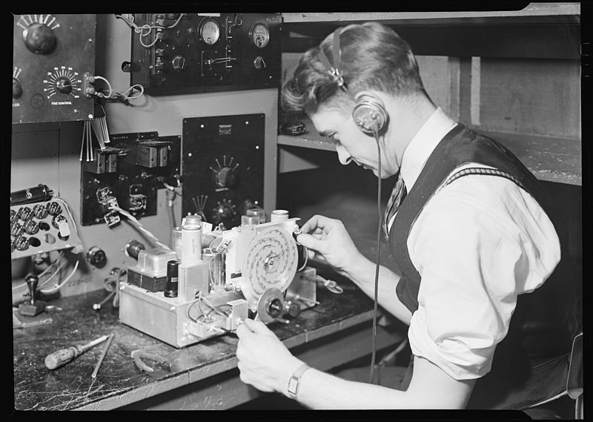


When do we find performance problems?
Developers
Unit/Integration Tests
Acceptance
Tests
Capacity
Tests
Release
?
?
?
Notes:
Do you find them in development, testing, or after the production deployment when your users are starting to hit your site?

Slide 4
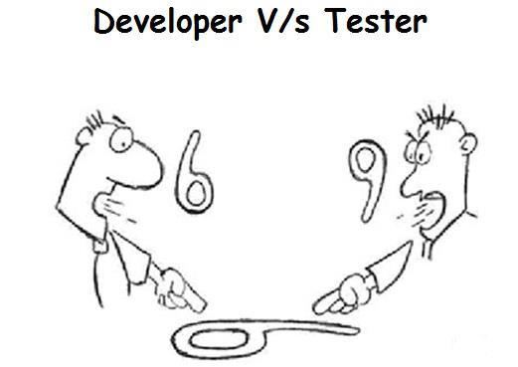
Notes:
A lot of time developers and testers see the world from a DIFFERENT POINT of View

Slide 5

Notes:
Nobody wants these bugs that testers are discovering all the time …

Slide 6

Notes:
Feedback loop between dev and test is often not very well established

Slide 7
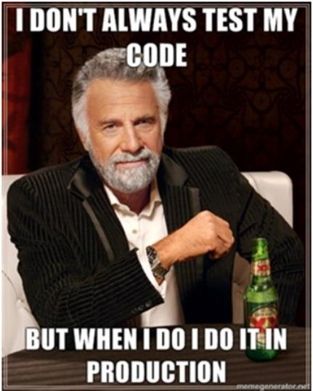
Notes:
Due to time constraints we also often end up with this

Slide 8
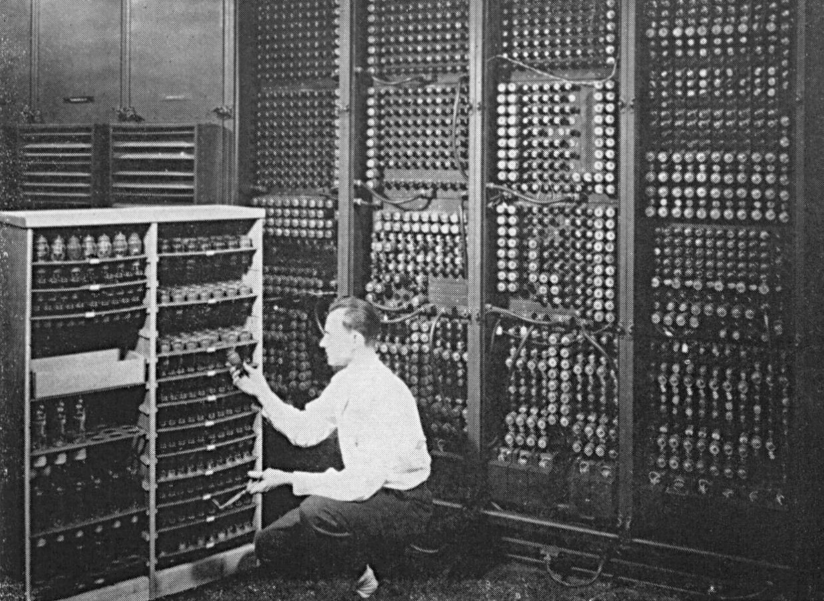
Test
Notes:
Test environment and production environments often don‘t look very similar

Slide 9

Production

Slide 10

Dev
Ops
Notes:
And even if we master the collaboration between dev and test, we still have to worry about the collaboration with operations!

Slide 11
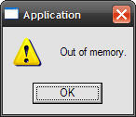
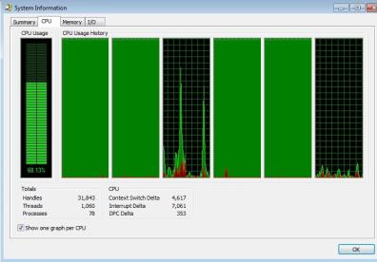
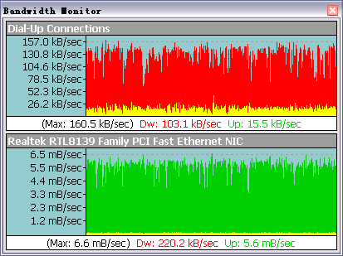
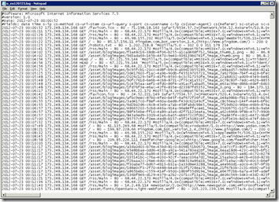
What Operations tells Developers…
Notes:
They Get
High CPU, Memory or Bandwidth Issues
Log files: GB’s of logfiles with 99.9% “useless” information

Slide 12
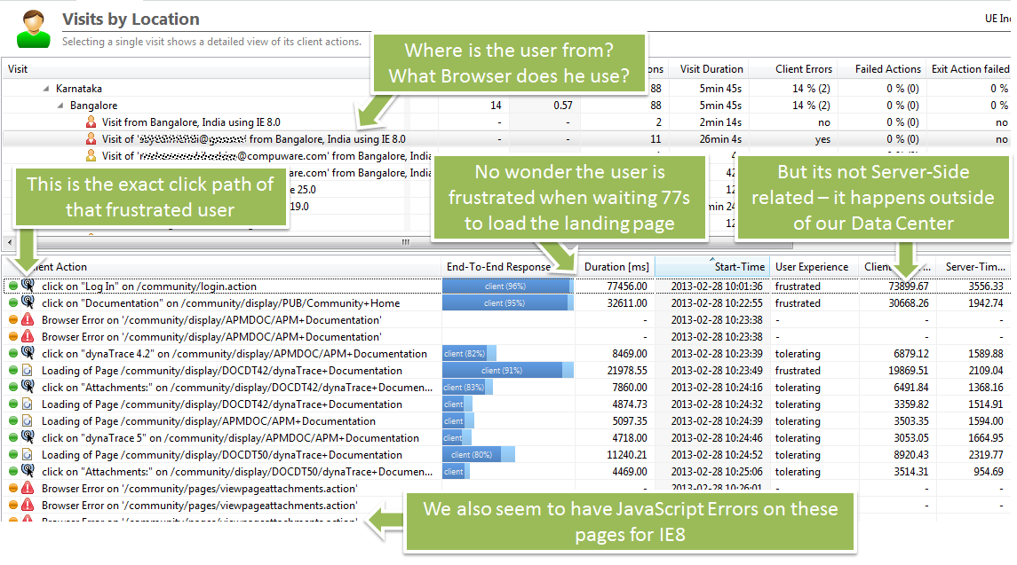
What Developers would like to know

Slide 13
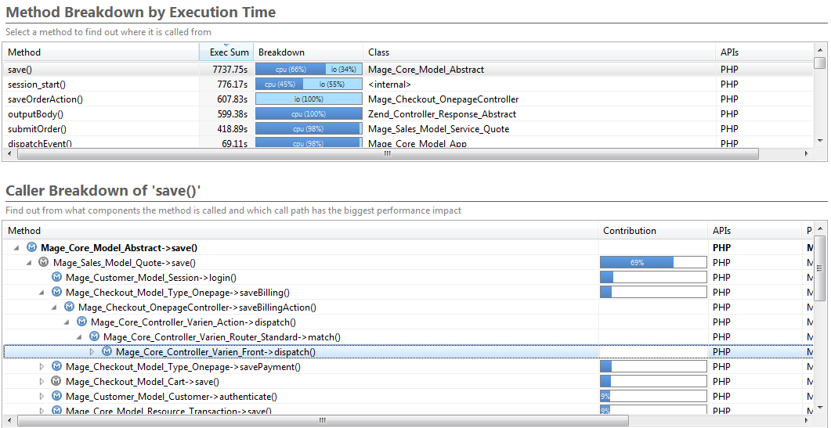
What Developers would like to know
Top contributor is save of Mage_Core_Model_Abstract
70% of that time comes from Sales_Model_Quote
Where are those calls coming from?

Slide 14

Notes:
I have a dream where

Slide 15

Notes:
We should start by figuring out that we are all ONE TEAM working on a COMMON GOAL
And this should be easy – BECAUSE …

Slide 16
Because
NOBODY wants this …

Slide 17
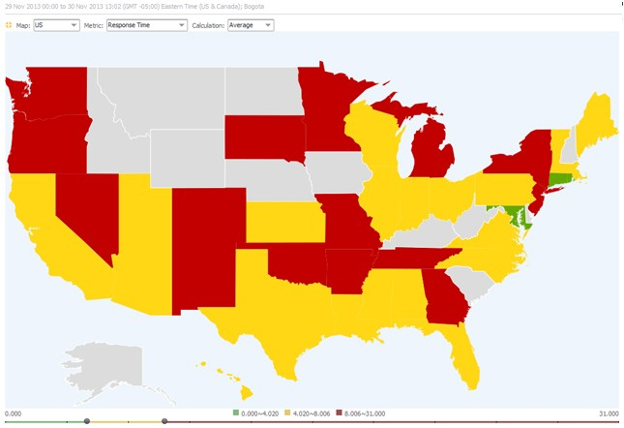
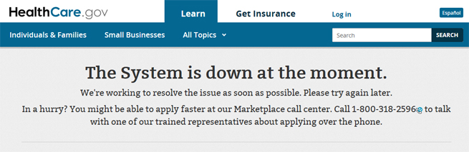


Slide 18
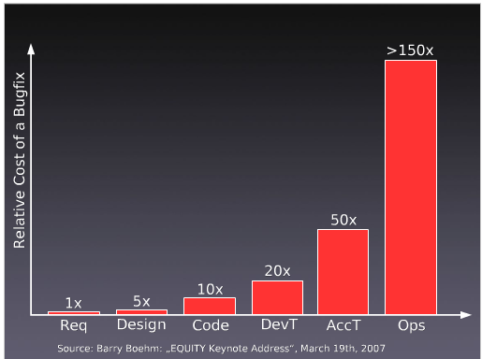
YES we know this
80% Dev Time in Bug Fixing
$60B Defect Costs
BUT
~80% of problems
caused by ~20% patterns
Notes:
Its very expensive and we cant develop as many new cool products as we need to keep our jobs
INTERESTINGLY – its always the same problems we see out there that cause this pain

Slide 19

Broaden the View
Define metrics that are understood across teams
Share measurement methods and tools
Make performance part of agile stories

Slide 20

Notes:
Improve collaboration between Developers and Operators and
Stop wasting money
Stop wasting time
Stop frustrating people
Start building great systems

Slide 21


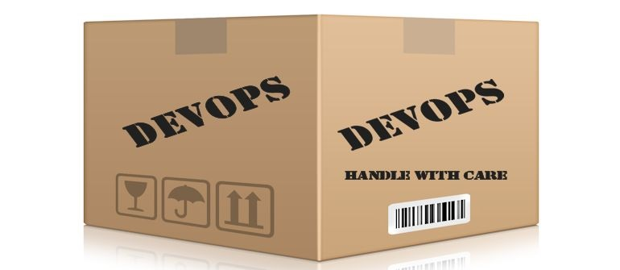
But…
Notes:
It’s not a set of tools, or a standard, or something you can buy in a box and just apply it

Slide 22
It’s a culture thing
Notes:
DevOps is a soft skill – don’t focus on tools, focus on the practice

Slide 23




Culture
Automation
Measure
Share
Notes:
So what is it?

Slide 24

Starting from…
Release
Developers
CI Server
Testing
Environment
Production
Environment
Notes:
Everyone measures, everyone has their own measures, little to no sharing

Slide 25
…or maybe…
Release
Developers
CI Server
Testing
Environment
Production
Environment
Notes:
Everyone measures, everyone has their own measures, little to no sharing

Slide 26
We want to get to…
Developers
Commit
Stage
Automated
Acceptance
Testing
Automated
Capacity
Testing
Release
Notes:
The problem is that while we have done a pretty good job recently to improve production monitoring, we often lack that systematic approach in earlier stages of a deployment pipeline. Let’s take a quick look at such a pipeline

Slide 27
METRICS to look at,
WHY we want them,
HOW they help

Slide 28

Queues and Pools

Slide 29
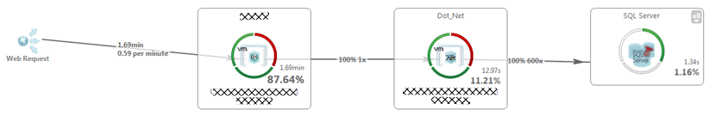
Online Banking: Slow Balance Check
1.69min (=101s!) To check balance!
87% spent in IIS
600! SQL Executions

Slide 30
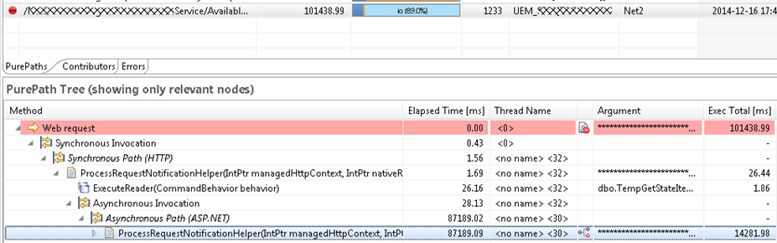
#1: Time Spent in IIS?
Thread 32 in IIS took 87s to pass control to Thread 30 in ASP.NET

Slide 31
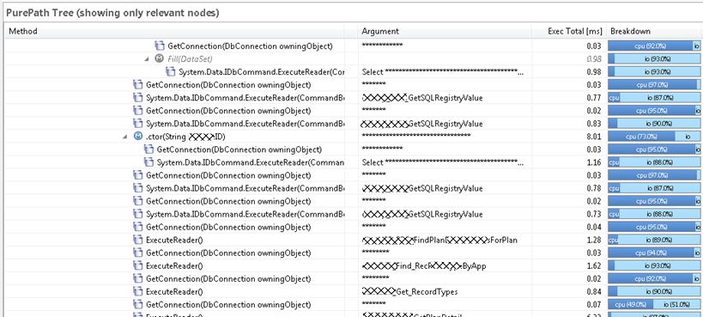
#2: SQL Executions!
A new connection for every statement…

Slide 32
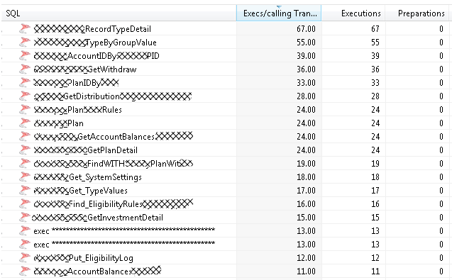
#2: SQL Executions! continued …
#1: Same SQL is executed 67! times
#2: NO PREPARATION because everything executed on new Connection

Slide 33
Lessons Learned!
ASP.NET Worker Thread Pool Sizing!
DB Connection Pools
More Efficient SQL

Slide 34

Helpful Metrics
Idle vs. Busy Threads
# SQLs / Request
# Opened connections

Slide 35
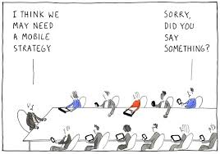
Push without Plan

Slide 36
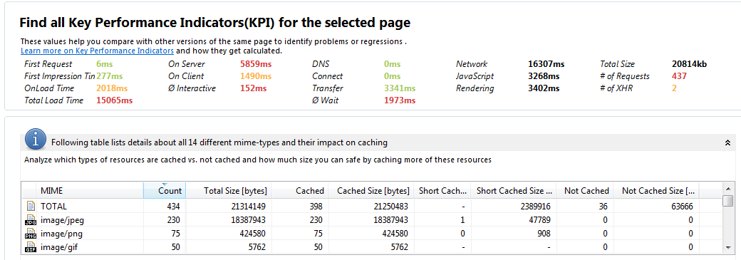
Mobile Landing Page of Super Bowl Ad
Total size of ~ 20MB
434 Resources in total on that page:
230 JPEGs, 75 PNGs, 50 GIFs, …
http://apmblog.dynatrace.com/2014/01/31 /technical-and-business-web-performance-tips-for-super-bowl-ad-landing-pages/

Slide 37
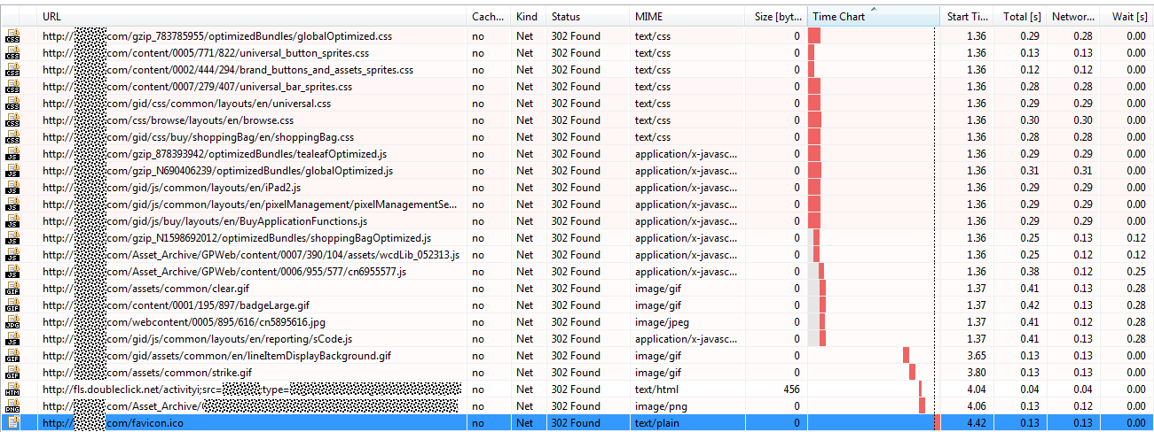
m.store.com redirects to www.store.com
ALL CSS and JS files are redirected to the www domain
This is a lot of time “wasted” especially on high latency mobile connections
http://apmblog.dynatrace.com/2013/12/02/the-terrible-website-performance-mistakes-of-mobile-shopping-sites-in-2013/

Slide 38
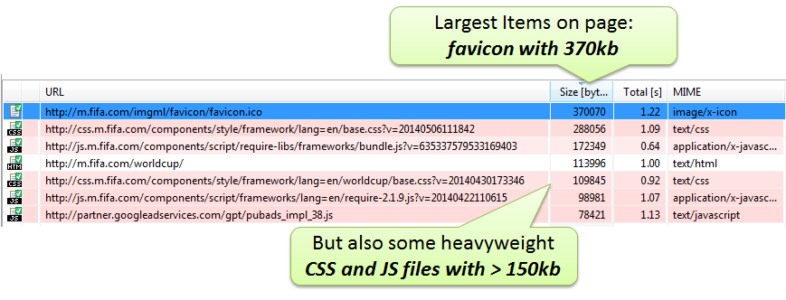
Fifa.com during Worldcup
http://apmblog.dynatrace.com/2014/05/21/is-the-fifa-world-cup-website-ready-for-the-tournament/

Slide 39
Helpful Metrics
Load Time
# Images
# Redirects
# HTTP 3xx, 4xx, 5xx
Size of resources

Slide 40

Reusing Components

Slide 41
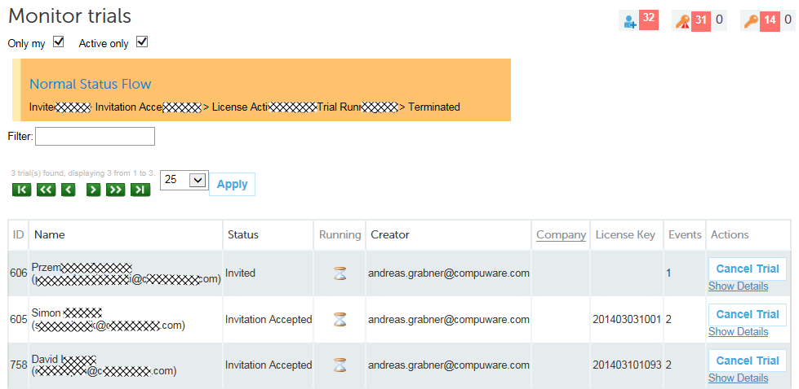
Requirement: We need a report

Slide 42
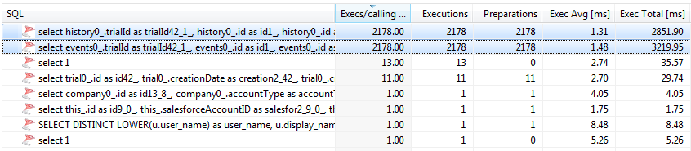
Using Hibernate results in 4k+ SQL Statements to display 3 items!
Hibernate Executes 4k+ Statements
Individual Execution VERY FAST
But Total SUM takes 6s
http://apmblog.dynatrace.com/2014/04/23/database-access-quality-metrics-for-your-continuous-delivery-pipeline/

Slide 43
Helpful Metrics
# SQL Statement Executions
# of same SQLs
Result Set Size

Slide 44

Tools and Frameworks

Slide 45
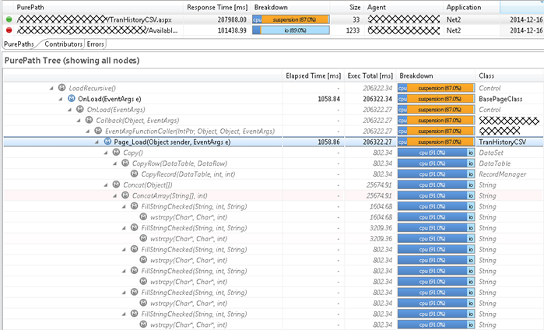
Online Bank: Transaction History CSV Download!
Problem: Takes 207s! To download. 87% of Time spent in Garbage Collection
Building CSV output in memory…

Slide 46
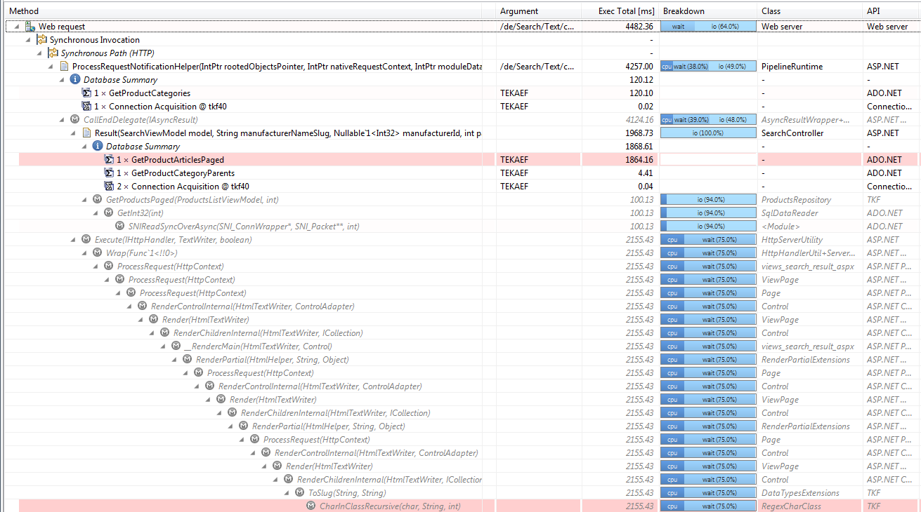
Online Store: Rendering Search Result
Problem: 4.4s to render result page
Root Cause: Custom RegEx Library with performance issues on large strings

Slide 47
Helpful Metrics
Memory Usage
Time Spent in APIs

Slide 48

Architectural
Decisions

Slide 49
Project: Online Room Reservation System
Symptoms
HTML takes between 60 and 120s to render
High GC Time
Assumptions
Bad GC Tuning
Probably bad Database Performance as rendering was simple

Slide 50
Developers built own monitoring
void roomreservationReport(int roomid)
{
long startTime = System.currentTimeMillis();
Object data = loadDataForRoom(roomid);
long dataLoadTime = System.currentTimeMillis() - startTime;
generateReport(data, roomid);
}
Result:
Avg. Data Load Time: 45s!
DB Tool says:
Avg. SQL Query: <1ms!

Slide 51
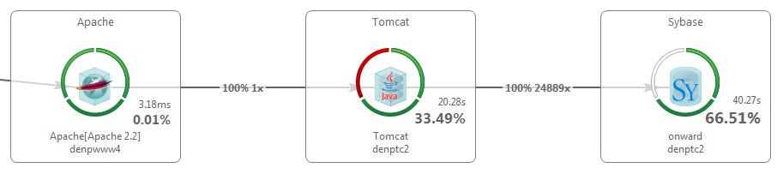
#1: Loading too much data
24889! Calls to the Database API!
High CPU and High Memory Usage to keep all data in Memory

Slide 52
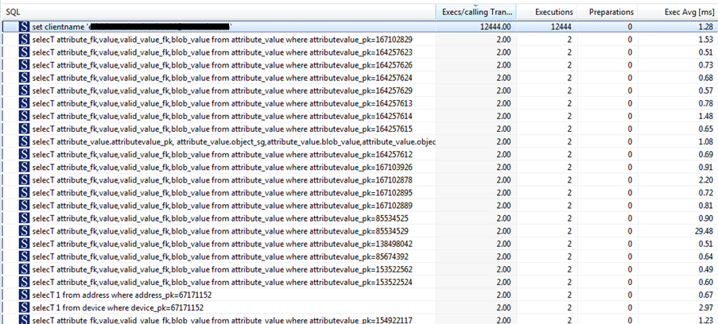
#2: On individual connections
12444! individual connections
Individual SQL really <1ms
Classical N+1 Query Problem

Slide 53
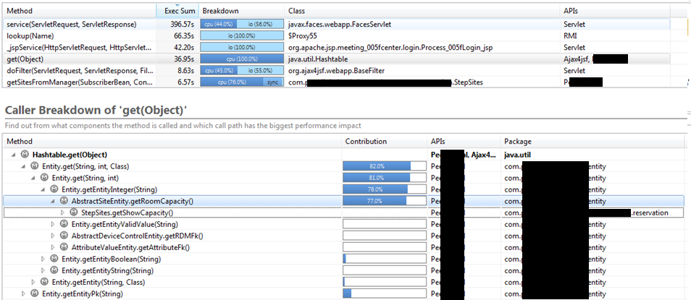
#3: Putting all data in temp Hashtable
Lots of time spent in Hashtable.get
Called from their Entity Objects

Slide 54
Lesson Learned
Custom Measuring
Was impacted by Garbage Collection
Just measured overall time but not # SQL Executions
Learn SQL and don’t use Hashtables as Workaround
void roomreservationReport(int roomid)
{
long startTime = System.currentTimeMillis();
Object data = loadDataForRoom(roomid);
long dataLoadTime = System.currentTimeMillis() - startTime;
generateReport(data, roomid);
}

Slide 55
Helpful Metrics
# SQL Executions
# of SAME SQLs
Connection Acquisition Time

Slide 56
Automated collection of performance metrics in test runs
Measurements accessible and shareable across teams
Automated analysis of performance metrics to identify outliers
Performance as a Quality Gate
Comparison of performance metrics across builds
Integration with build automation tools and practices
Automated notifications on performance issues in tests
Actionable data through deep transactional insight

Slide 57

PERFORMANCE as part of our Continuous Delivery Process
Developers
Commit
Stage
Automated
Acceptance
Testing
Automated
Capacity
Testing
Release
Notes:
The problem is that while we have done a pretty good job recently to improve production monitoring, we often lack that systematic approach in earlier stages of a deployment pipeline. Let’s take a quick look at such a pipeline

Slide 58
Remember: Use Tools to measure…
# Calls into API
# Functional Errors
3rd Party calls
# of Domains
Total Page Size
# Items per Page
# AJAX per Page
# Images
# Redirects
Size of Resources
# SQL Executions
# of SAME SQLs
# of Connections
Time Spent in API
Notes:
SO – go start capturing and understanding the basics of these metrics

Slide 59


Performance
Scalability
Notes:
Define metrics
Make them part of stories

Slide 60


Measure
Collaborate
Verify
Notes:
Once we got those metrics defined – make sure everyone on the team understands what they mean, how they’re measured and what to do with them
Improve ability to judge and verify potential impact of new features

Slide 61
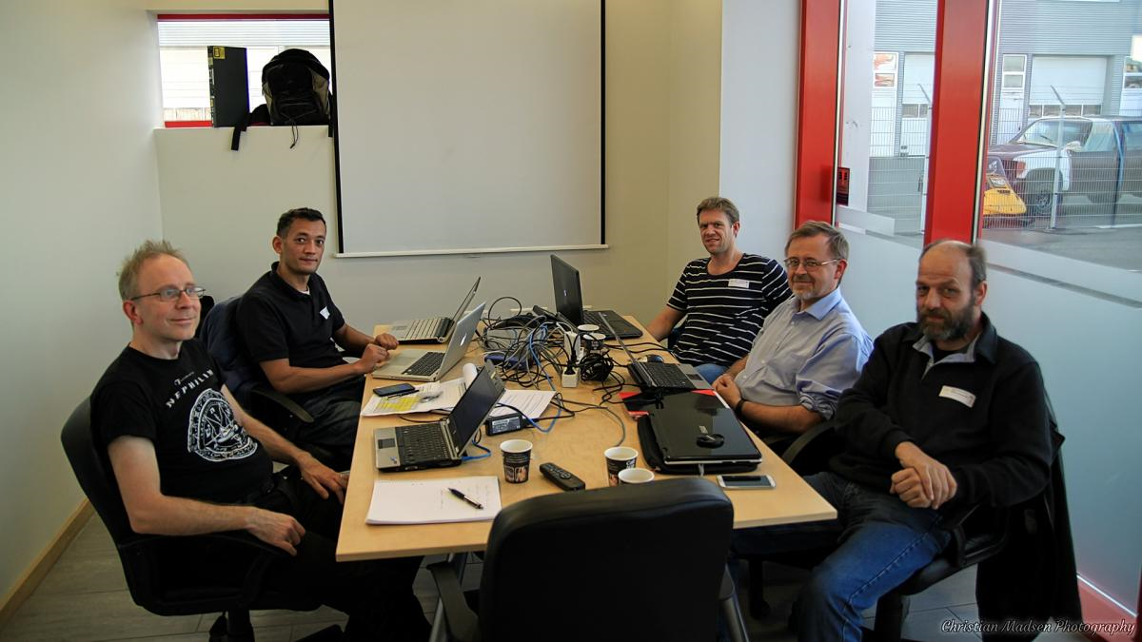
Notes:
You can easier get on the same table to discuss your findings

Slide 62
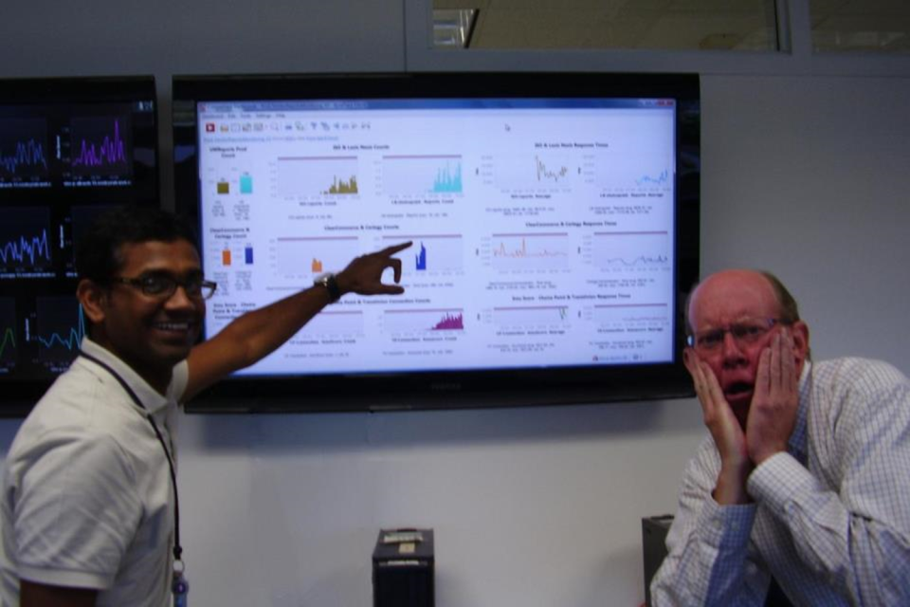
Notes:
Blaming somebody is then “fact/measure” based on facts

Slide 63
If we do
all that …

Slide 64

Developers
Unit/Integration Tests
Acceptance
Tests
Capacity
Tests
Release
Notes:
Do you find them in development, testing, or after the production deployment when your users are starting to hit your site?

Slide 65
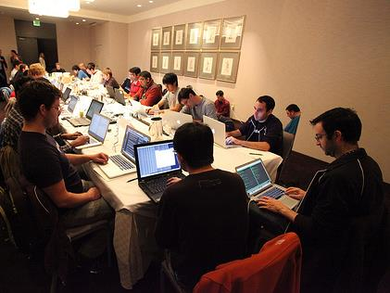
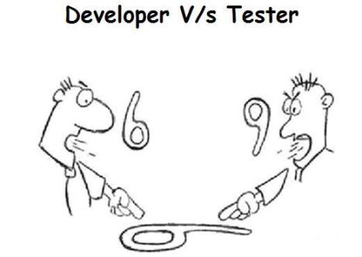

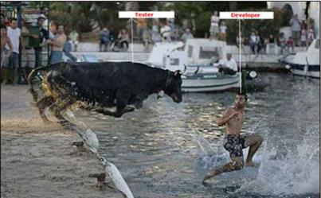
CANCELLED
Notes:
The War Room as all other crazy stuff is canceled …

Slide 66
… so there
is more time for …

Slide 67


Slide 68
blog.dynatrace.com
bit.ly/dttrial

Slide 69
A FINAL THOUGHT!

Slide 70
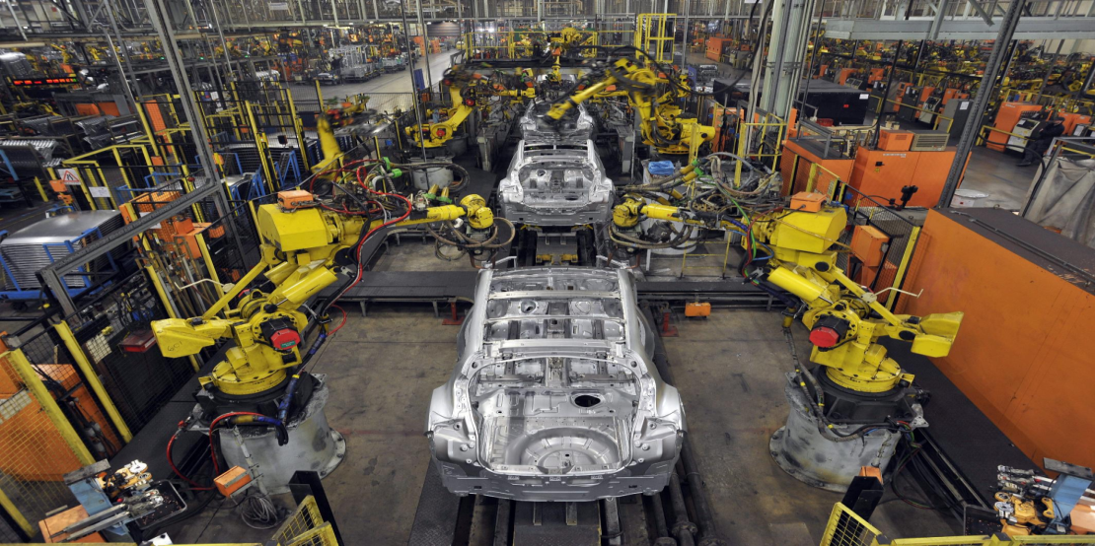

Slide 71
Putting it into Test Automation
Let’s look behind the scenes
Test Framework Results
Architectural Data
Build # | Test Case | Status
# SQL | # Excep | CPU
Build 17 | testPurchase | OK
 | testSearch | OK
12 | 0 | 120ms
3 | 1 | 68ms
Build 18 | testPurchase | FAILED
 | testSearch | OK
12 | 5 | 60ms
3 | 1 | 68ms
Build 19 | testPurchase | OK
 | testSearch | OK
75 | 0 | 230ms
3 | 1 | 68ms
Build 20 | testPurchase | OK
 | testSearch | OK
12 | 0 | 120ms
3 | 1 | 68ms
We identified a regresesion
Exceptions probably reason for failed tests
Problem fixed but now we have an architectural regression
Problem solved
Problem fixed but now we have an architectural regression
Now we have the functional and architectural confidence

Slide 72

And in your Pipeline
Unit & Integration Tests
Performance Tests
Production
Monitoring
Commit Stage
Compile
Execute Unit Test
Code Analysis
Build installers
Automated
Acceptance
Testing
Automated
Capacity
Testing
Manual testing
Key showcases
Exploratory testing
Release
Functional Tests
Functional Tests

Slide 73

Wolfgang Gottesheim
Free Tools: http://bit.ly/dttrial
Follow me @gottesheim
Email me wolfgang.Gottesheim@dynatrace.com
http://blog.dynatrace.com

